Slide 1
IL code generator
Compiler design principles
Dr. Saeed Parsa
Presesnter: Kawan FarhadiBaneh
12/25/2023

Slide 2
IL generation steps
Write A grammar
Generate A Lexer and Parser from your grammar
Write your input and a script that specifies the flow of your program (main script)
Write a custom listener to generate an Abstract syntax tree (AST) from the parse tree
If your AST is binary, transform it to a normal AST
Perform post-order traversal on your AST and store it.
Generate IL code from the post-order traversal of the AST
Write the IL code to a file with the “.il” extension
Use ilasm.exe to produce an executable file for your “.il” file
Run your executable file

Slide 3
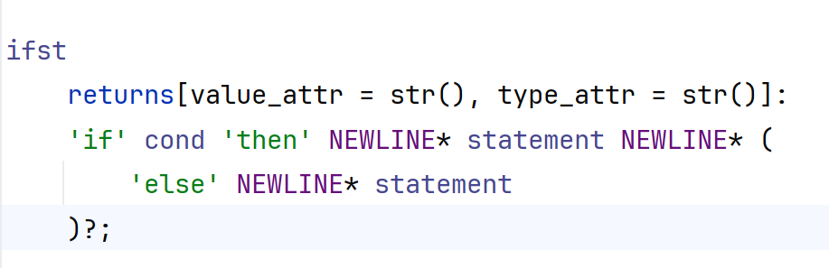
Step 1- Define grammar
Grammar is used to define the rules that should be followed, and the default lexer and parser can be generated from it. Below are two sample production rules:

Slide 4

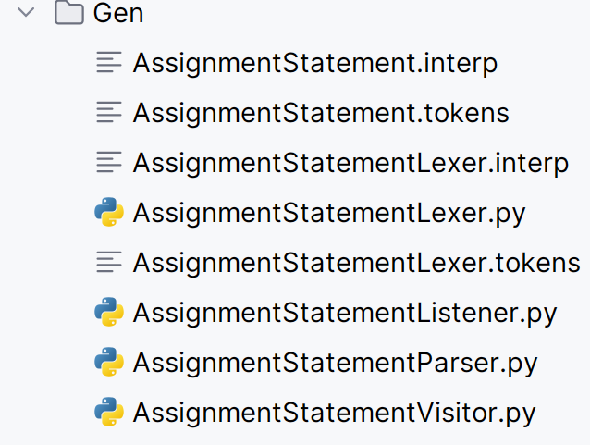
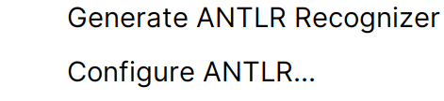
Step 2- Generate ANTLR recognizer

Slide 5
Step 3- Write the main() function
Input:
The following code fragment of the main script accepts a program written using the given syntax and passes it to the main function which generates the corresponding IL code for the given input:
if __name__ == '__main__': argparser = argparse.ArgumentParser() argparser.add_argument( '-n', '--file', help='Input source', default=r'input3.txt') args = argparser.parse_args() main(args)

Slide 6
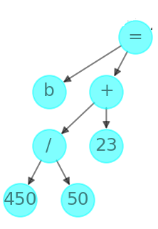
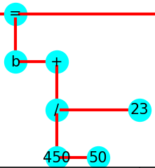
Step 3- generate output from sample input:
Input: b := 450 /50 + 23
4
'b', '450', '50', '/', '23', '+', '='
Output:
ldc.i8 450 ldc.i8 50 div ldc.i8 23 add stloc b
1
3
2

Slide 7
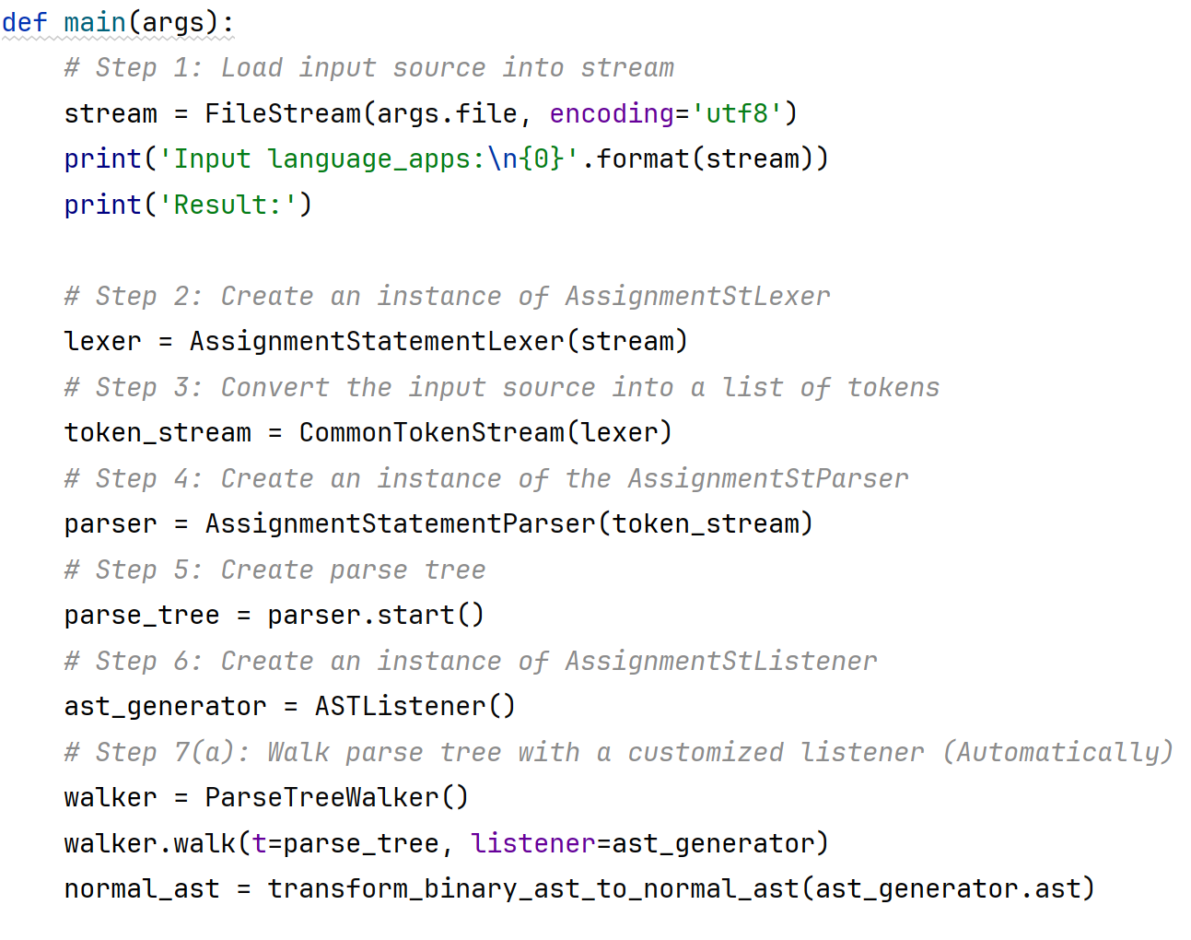
Step3.1: create binary AST
1
Create the lexer object for the given input stream, tokenize the input stream, pass the tokenized input stream to the parse to create a parse tree. Instantiate the ASTListener class.
To build an AST while invoked by the TreeWalker. Pass the ASTListener and the parse tree to the tree walker to generate the binary ast while walking through the parse tree

Slide 8
Step3.2: transform binary AST to n-ary AST
2
normal_ast = transform_binary_ast_to_normal_ast(ast_generator.ast)
Using the transform_binary_ast_to_normal_ast() function from the AST script defined in the Code directory, transform the binary AST to n-ary AST.
This function aims to convert a binary abstract syntax tree (AST) to a normal AST. A binary AST is a tree where each node has at most two children, while a normal AST is a tree where each node can have any number of children.

Slide 9
Step3.3: post-order traversal of the AST
3
s = 0 # choose a source node post_order_traversal =[] for node in nx.dfs_postorder_nodes(graph, source=s): label = graph.nodes[node].get('label', 'No label') post_order_traversal.append(label) # display the node
Retrieve the post-order traversal of the AST by utilizing the dfs_postorder_nodes of the network library in Python:

Slide 10
Step3.4: generate IL from post-order traversal
4
il_mapper = ILMapper() il_mapper.generate_intermediate_language(post_order_traversal)
Create an instance of the ILMapper class, then pass the post-order traversal to the generate_intermediate_language() function. This function is the starting point for generating IL code based on the post-order traversal.

Slide 11
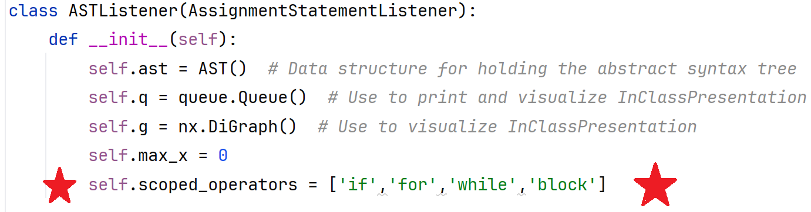
Step 4: Write a custom listener
By using a custom listener and overriding the exit and enter functions of its parent we can define actions to be taken when traversing the parse tree when using a walker and by we can produce the desired results.

Slide 12
Sample input
Begin
b := 450 / 50 + 23
c := 14 * 150
f := b>c ? 78 : 8+3 == 9+2 ? 69 : 48 * 2
if f > 45 then
begin
f := f – 45
output := f
end
else
output := 88
End

Slide 13
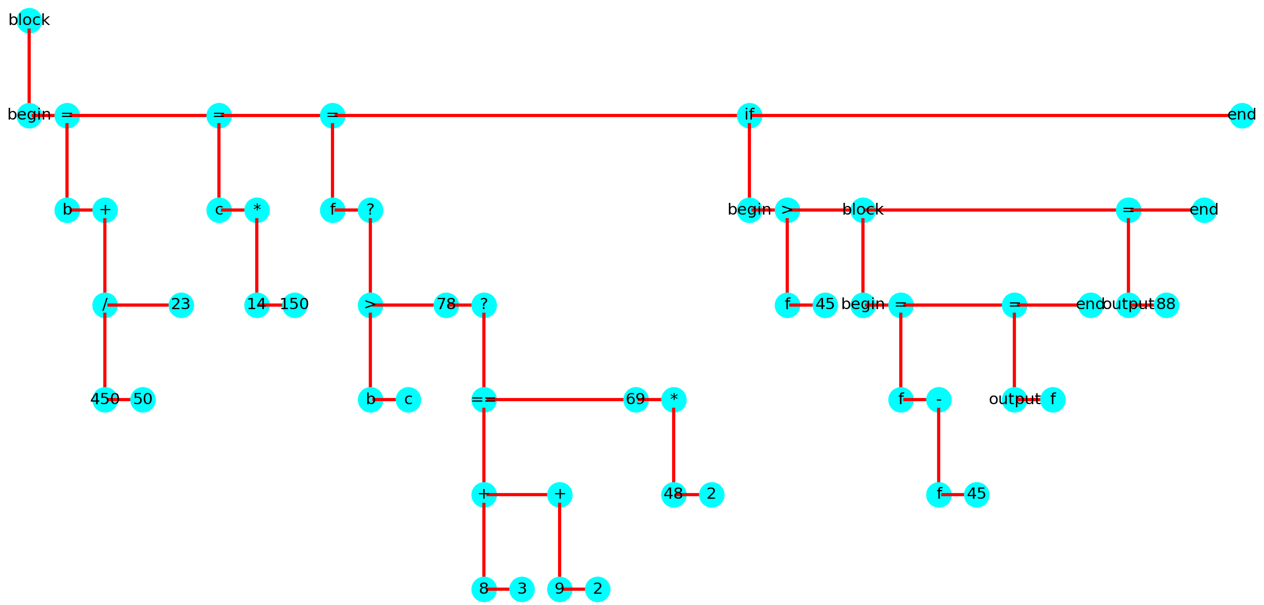
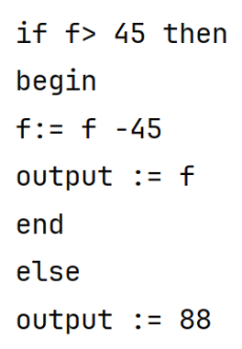

Binary AST

Slide 14
Step 5: Transform Binary to normal AST
Post order traversal of our custom binary tree requires a custom algorithm to be done. By transforming the Binary AST to Normal AST we can achieve the same result using standard libraries defined in networkx library in python.

Slide 15
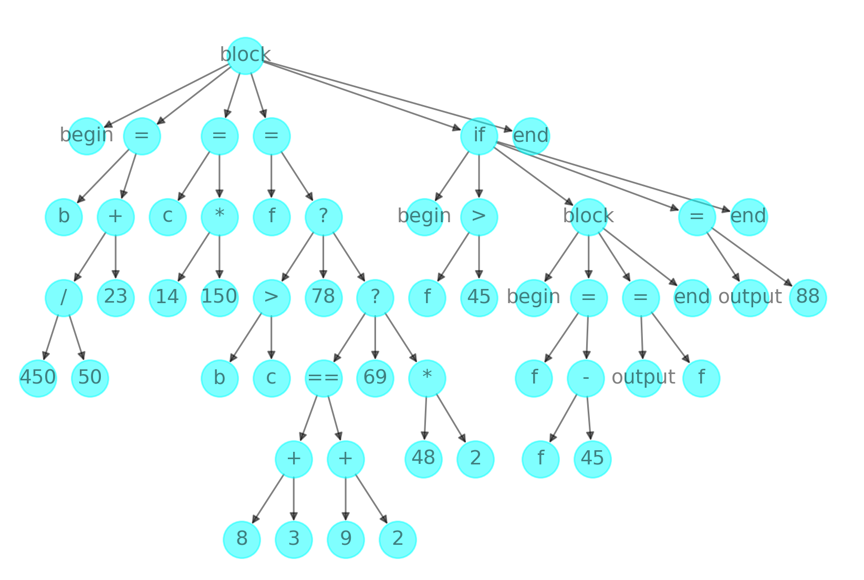
Normal AST

Slide 16
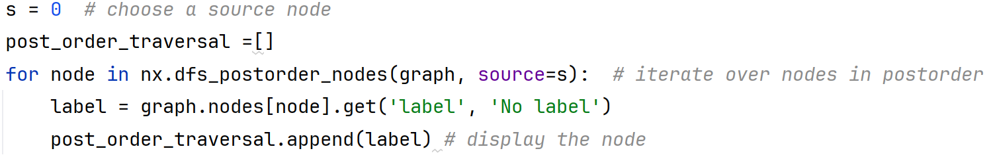
Step 6: Post-order traversal of AST
Using the resulting post-order traversal we can generate IL code.
We prefer using post-order traversal because the operands are visited before the operators, which is similar to how most ILs are structured

Slide 17
Post-order traversal
['begin’,
'b’, '450’, '50’, '/’, '23’, '+’, ‘=‘,
'c’, '14’, '150’, '*’, ‘=‘,
'f’, 'b’, 'c’, '>’, '78’, '8’, '3’, '+’, '9’, '2’, '+’, '==‘, '69’, '48’, '2’, '*’, '?’, '?’, ‘=‘,
'begin’, 'f’, '45’, ‘>’,
'begin’, ‘f’, 'f’, '45’, '-’, '=‘, 'output’, 'f’, '=‘, 'end’, 'block’,
'output’, '88’, '=‘, 'end’, 'if’,
'end’, 'block’ ]

Slide 18
Post-order traversal
['begin’,
'b’, '450’, '50’, '/’, '23’, '+’, ‘=‘,
'c’, '14’, '150’, '*’, ‘=‘,
'f’, 'b’, 'c’, '>’, '78’, '8’, '3’, '+’, '9’, '2’, '+’, '==‘, '69’, '48’, '2’, '*’, '?’, '?’, ‘=‘,
'begin’, 'f’, '45’, ‘>’,
'begin’, ‘f’, 'f’, '45’, '-’, '=‘, 'output’, 'f’, '=‘, 'end’, 'block’,
'output’, '88’, '=‘, 'end’, 'if’,
'end’, 'block’ ]

Slide 19

Using the ILMapper class from main
Create an instance of the ILMapper class, then pass the post-order traversal to the generate_intermediate_language() function. This function is the starting point for generating IL code based on the post-order traversal.

Slide 20
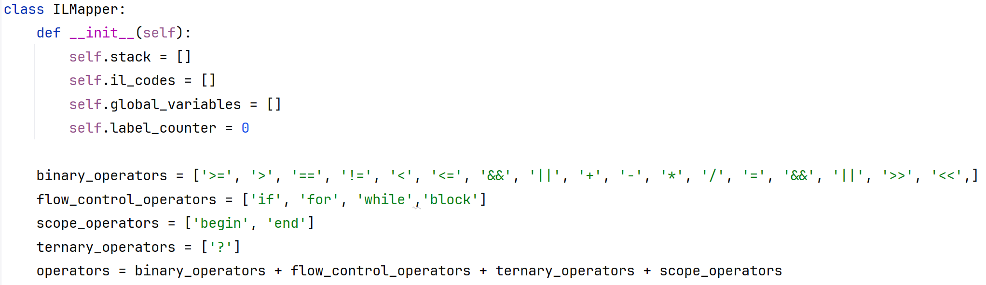
ILMapper class
The ILMapper class is responsible for generating IL code from the post-order traversal of the given input program.

Slide 21
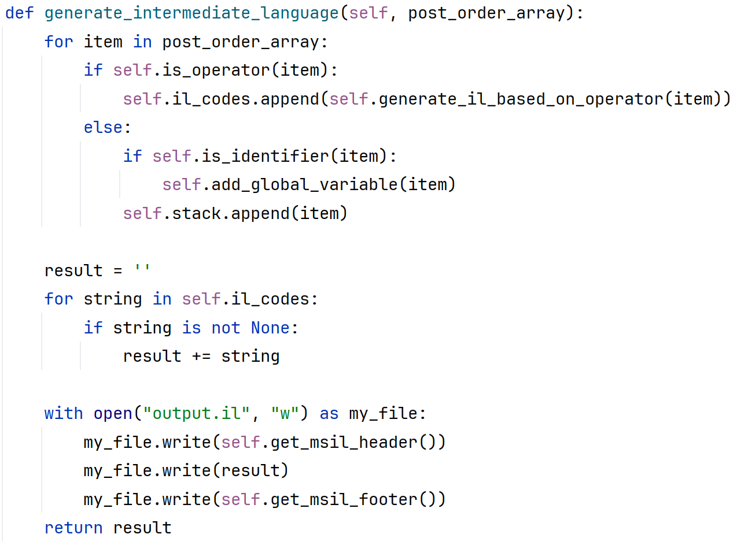
ILMapper Core functions
The generate_intermediate_language function iterates through the post-order traversal and does the following based on the type of the item:
If the item is an operand, it gets pushed onto the ILMapper stack.
If the item is an operator, it is passed to the generate_il_based_on_operator function, and the function result is added to the il_codes array of the ILMapper class.
after the iteration of the post-order traversal is finished, the necessary header is written to the output file. The generated il codes are appended, and the footer is appended.

Slide 22
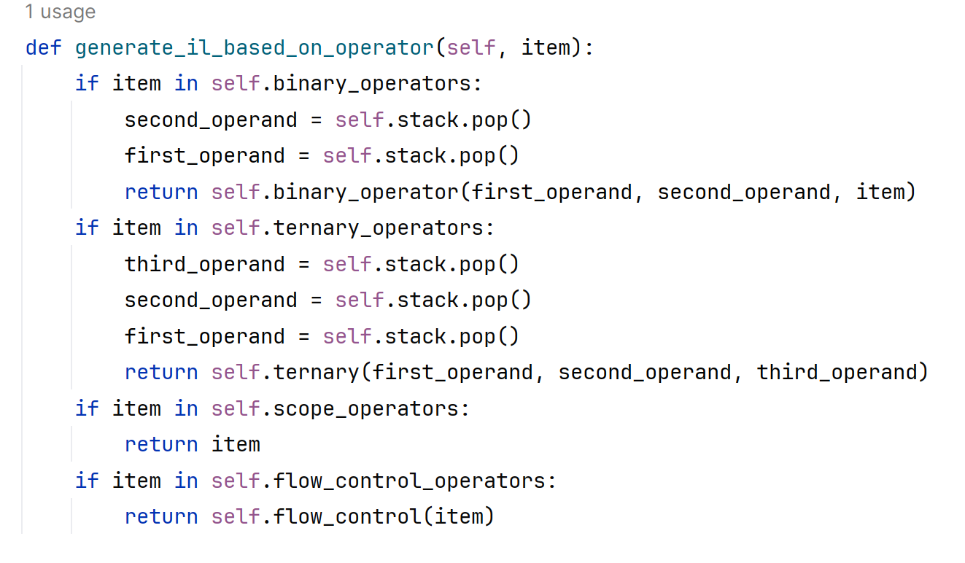


ILMapper Core functions

Slide 23
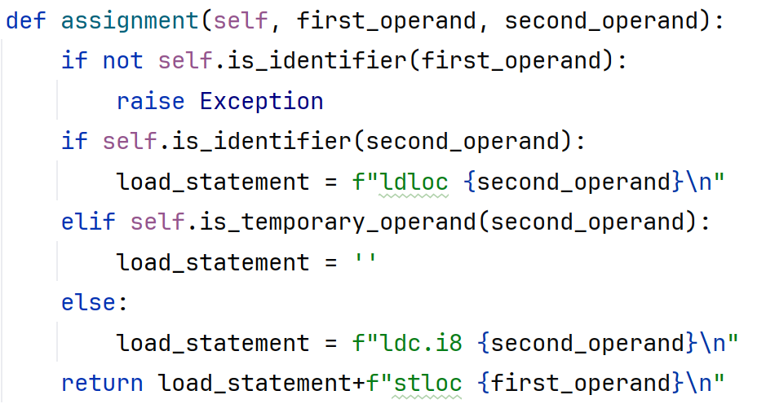
ILMapper code generation for assignment

Slide 24
ILMapper code generation example:
'b’, '450’, '50’, '/’, '23’, '+’, ‘=‘,
ILMapper stack
b
ILMapper il_codes
IL Runtime Stack

Slide 25
ILMapper code generation example:
'b’, '450’, '50’, '/’, '23’, '+’, ‘=‘,
ILMapper stack
450
b
ILMapper il_codes
IL Runtime Stack

Slide 26
ILMapper code generation example:
'b’, '450’, '50’, '/’, '23’, '+’, ‘=‘,
ILMapper stack
50
450
b
ILMapper il_codes
IL Runtime Stack

Slide 27
ILMapper code generation example:
'b’, '450’, '50’, '/’, '23’, '+’, ‘=‘,
ILMapper stack
50
450
b
ILMapper il_codes
ldc.i8 450 ldc.i8 50 div
IL Runtime Stack
50
450

Slide 28
ILMapper code generation example:
'b’, '450’, '50’, '/’, '23’, '+’, ‘=‘,
ILMapper stack
b
ILMapper il_codes
ldc.i8 450 ldc.i8 50 div
IL Runtime Stack
50
450

Slide 29


ILMapper code generation example:
'b’, '450’, '50’, '/’, '23’, '+’, ‘=‘,
ILMapper stack
__Temporary
b
ILMapper il_codes
ldc.i8 450 ldc.i8 50 div
IL Runtime Stack
9

Slide 30
ILMapper code generation example:
'b’, '450’, '50’, '/’, '23’, '+’, ‘=‘,
ILMapper stack
23
__Temporary
b
ILMapper il_codes
ldc.i8 450 ldc.i8 50 div
IL Runtime Stack
9

Slide 31
ILMapper code generation example:
'b’, '450’, '50’, '/’, '23’, '+’, ‘=‘,
ILMapper stack
23
__Temporary
b
ILMapper il_codes
ldc.i8 450 ldc.i8 50 div
ldc.i8 23 add
IL Runtime Stack
23
9

Slide 32
ILMapper code generation example:
'b’, '450’, '50’, '/’, '23’, '+’, ‘=‘,
ILMapper stack
b
ILMapper il_codes
ldc.i8 450 ldc.i8 50 div
ldc.i8 23 add
IL Runtime Stack
23
9

Slide 33
ILMapper code generation example:
'b’, '450’, '50’, '/’, '23’, '+’, ‘=‘,
ILMapper stack
__Temporary
b
ILMapper il_codes
ldc.i8 450 ldc.i8 50 div
ldc.i8 23 add
IL Runtime Stack
32

Slide 34
ILMapper code generation example:
'b’, '450’, '50’, '/’, '23’, '+’, ‘=‘,
ILMapper stack
__Temporary
b
ILMapper il_codes
ldc.i8 450 ldc.i8 50 div
ldc.i8 23 add
stloc b
IL Runtime Stack
32

Slide 35
ILMapper code generation example:
'b’, '450’, '50’, '/’, '23’, '+’, ‘=‘,
ILMapper stack
ILMapper il_codes
ldc.i8 450 ldc.i8 50 div
ldc.i8 23 add
stloc b
IL Runtime Stack
32

Slide 36
ILMapper code generation example:
'b’, '450’, '50’, '/’, '23’, '+’, ‘=‘,
ILMapper stack
ILMapper il_codes
ldc.i8 450 ldc.i8 50 div
ldc.i8 23 add
stloc b
IL Runtime Stack

Slide 37
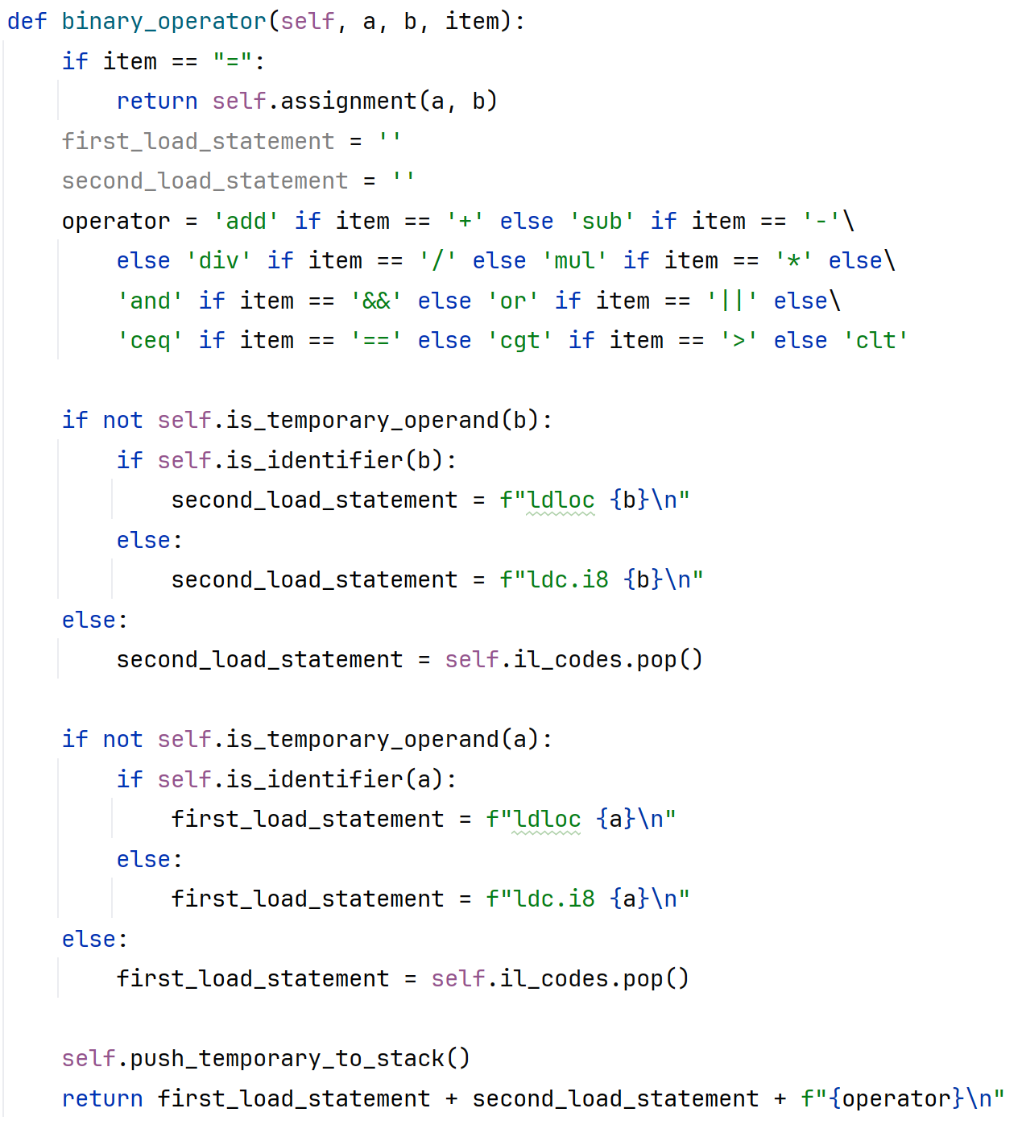
ILMapper code generation: binary operator

Slide 38
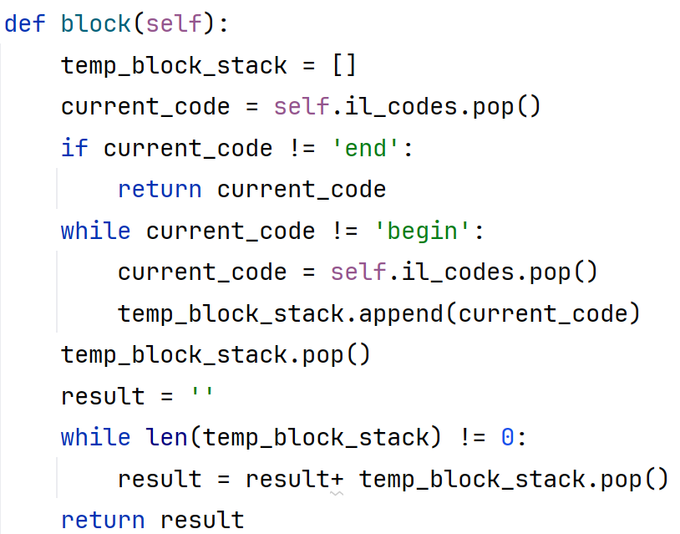
ILMapper code generation: block

Slide 39
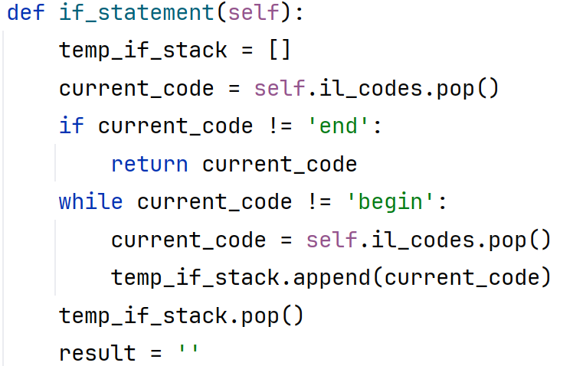
ILMapper code generation: if

Slide 40
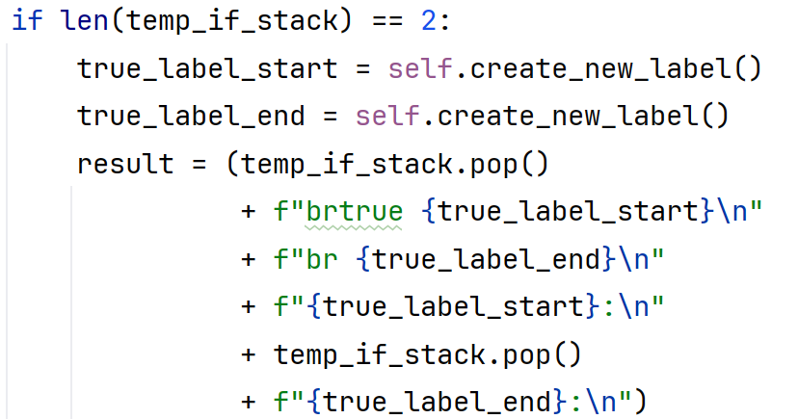
ILMapper code generation: if without else part

Slide 41
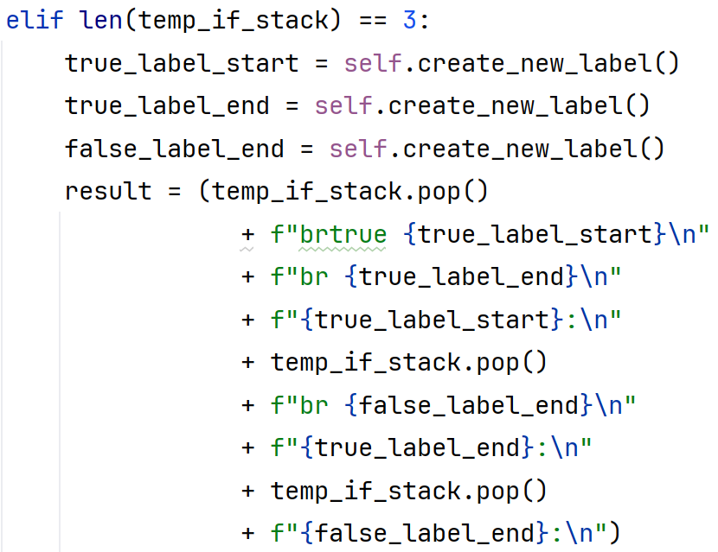
ILMapper code generation: if with else part

Slide 42
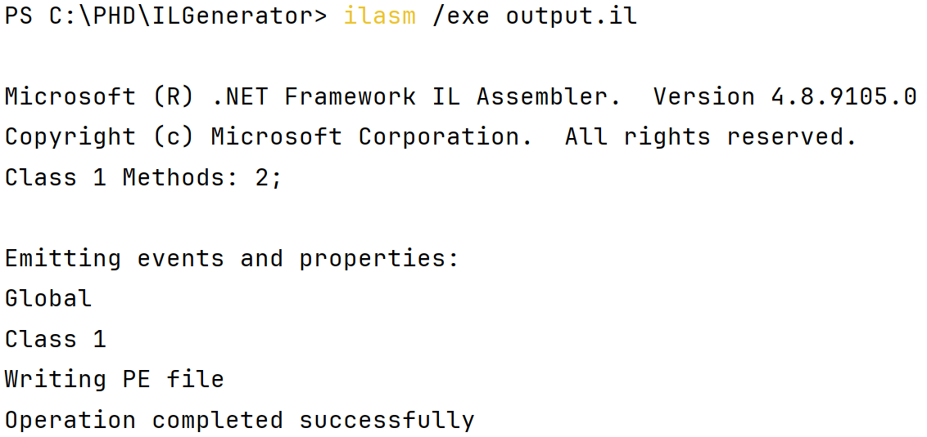
ilasm: command for building EXE file
ilasm /exe output.il

Slide 43

command running EXE file in windows

Slide 44
Homework:
Add code generation functionality for the following:
For loops
While loops
Greater than or equal to operator (“>=“)
Less than or equal to operator (“<=“)
Not equal to operator (“!=“)
The deadline for this homework is due on Saturday, 8th of Dey, 1402 (01/01/2024)

